Slide 1
CSE 445 Lecture 11
Model evaluation & selection

Slide 2
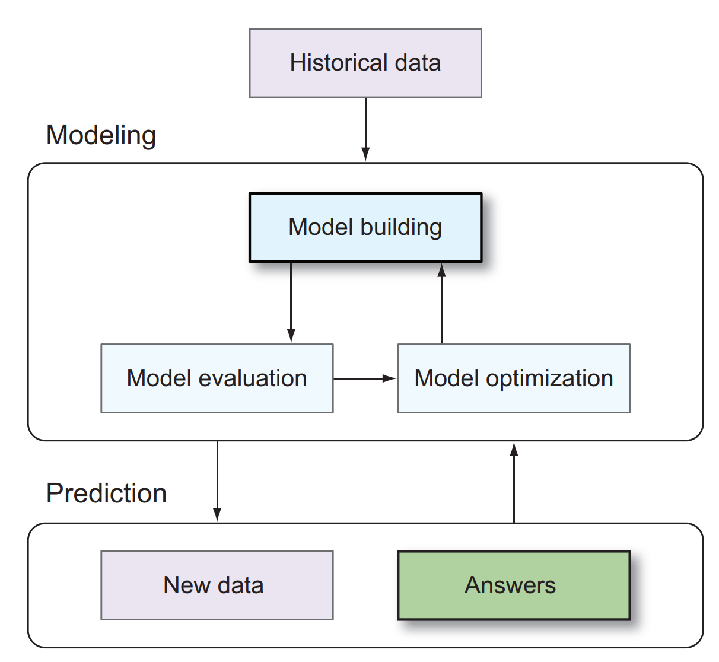
Pattern modeling
Different modeling approaches share a common workflow
Use of historical data to build and optimize a model
The model is used to make predictions based on new data

Slide 3
Why model evaluation?
The primary goal of supervised machine learning is accurate prediction
We want our model, which has been built from training data, to generalize well to new data
That way, when we deploy the model in production, we can be assured that the predictions generated are of high quality
Therefore, when we evaluate the performance of a model, we want to determine how well that model will perform on new data
This seemingly simple task is wrought with complications and pitfalls that can befuddle even the most experienced ML users
Model selection discusses bunch of methods for feature extraction and selection
However we need to be familiar with dimensionality reduction

Slide 4
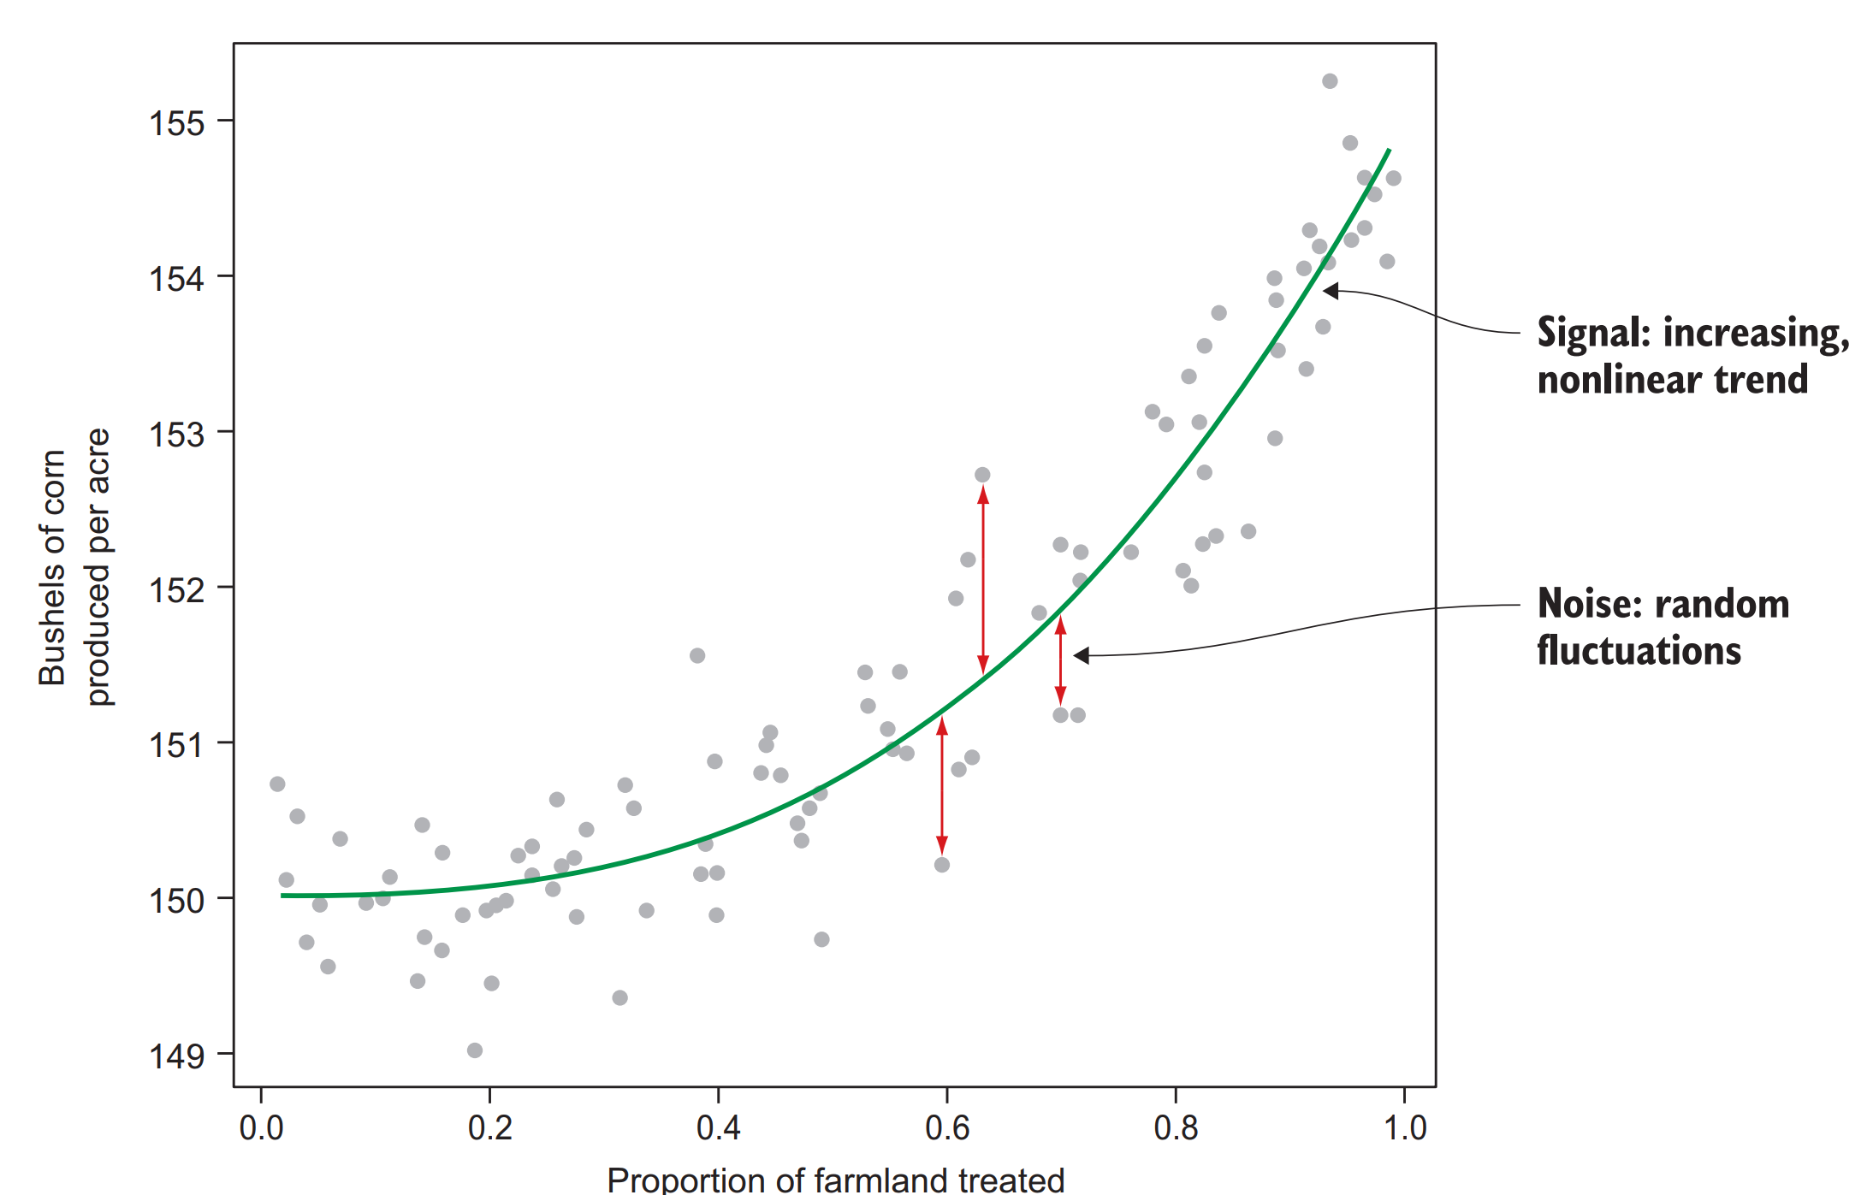
Problem 1: Overfitting
We want to predict the production of bushels of corn per acre on a farm as a function of the proportion of that farm’s planting area that was treated with a new pesticide
It is clear that an increasing, nonlinear relationship exists, and that the data also has random fluctuations

Slide 5
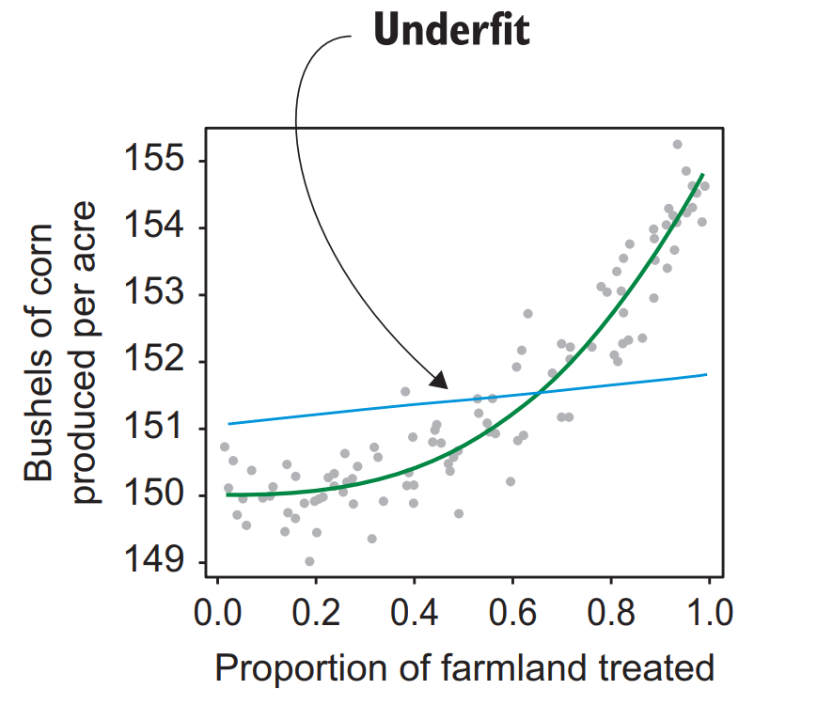
We will use kernel smoothing technique
For large values of the bandwidth, almost all of the training data is averaged together to predict the target, at each value of the input parameter
This causes the model to be flat and to underfit the obvious trend in the training data

Slide 6
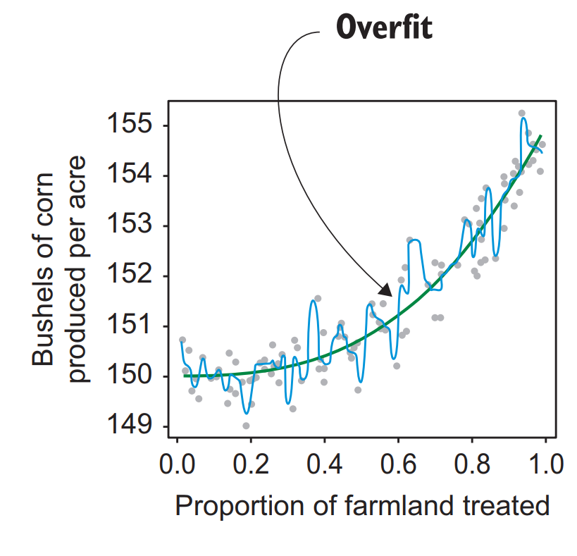
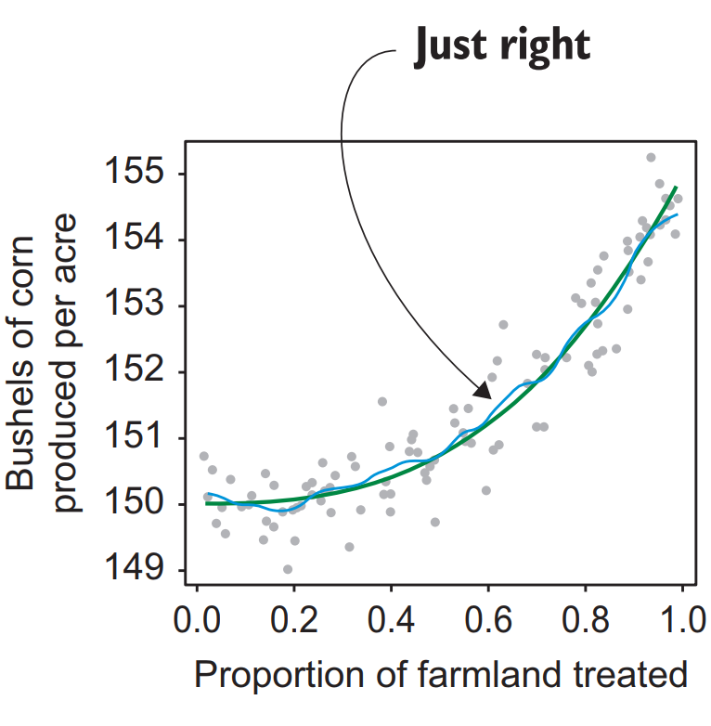
for small values of the bandwidth, only one or two training instances are used to determine the model output
Therefore, the model effectively traces every bump and wiggle in the data
This susceptibility to model the intrinsic noise in the data instead of the true signal is called overfitting

Slide 7
So what do we do now?
Determining how well ML model will generalize to predict the corn output from data on different farms
The first step in this process is to select an evaluation metric that captures the quality of the predictions
The simplest form of performance measurement of a regression model is the root mean-square error, or RMSE
This estimator looks at the difference from each of the predicted values to the known values, and calculates the mean in a way that’s immune to the fact that predicted values can be both higher and lower than the actual values

Slide 8
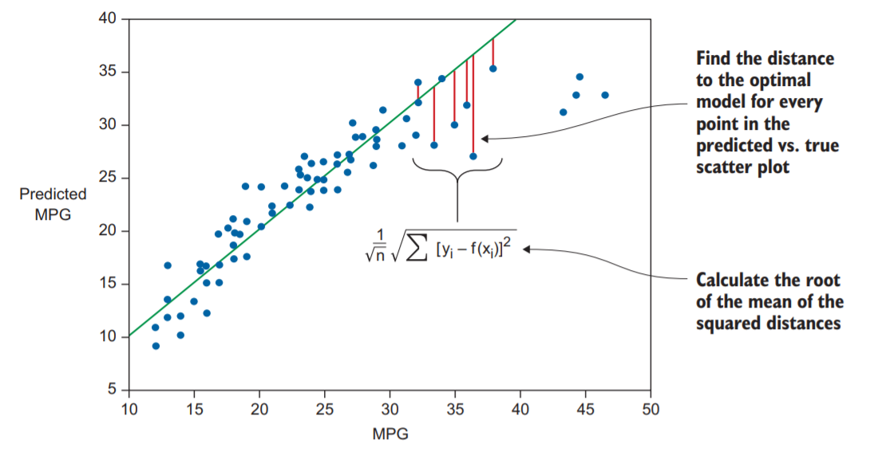
RMSE

Slide 9
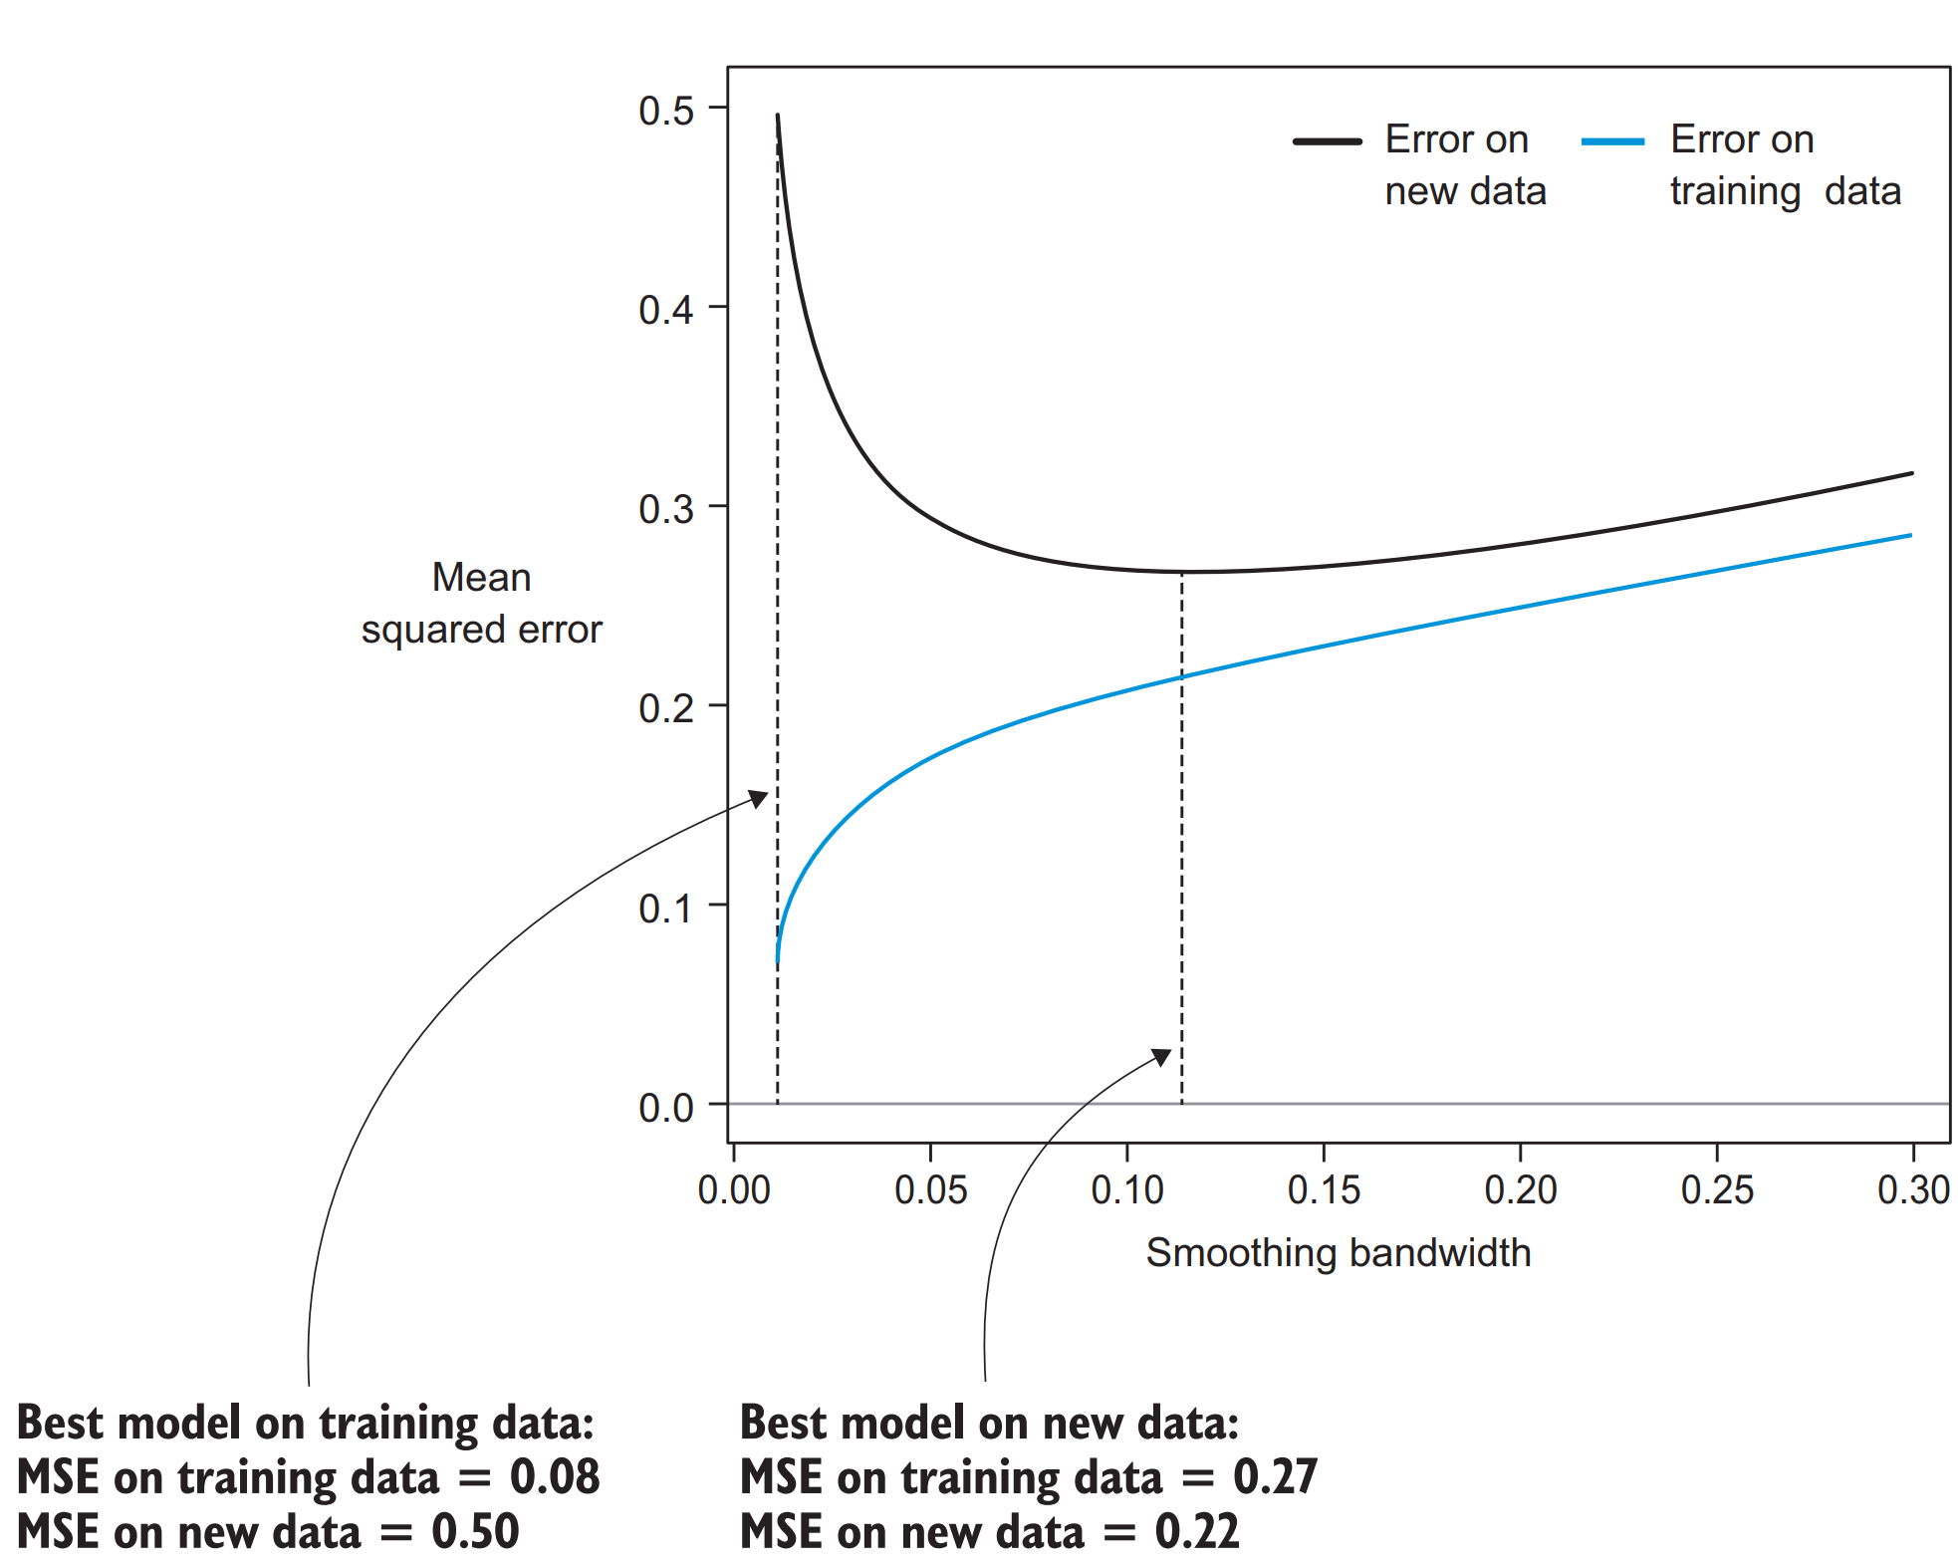
Pitfall – improve RMSE on training
For small values of the bandwidth parameter, the MSE evaluated on the training set is extremely small
Whereas the MSE evaluated on new data (in this case, 10,000 new instances) is much larger
Simply put, the performance of the predictions of a model evaluated on the training set isn’t indicative of the performance of that model on new data

Slide 10
Solution – cross validation
We’ve diagnosed the challenge in model evaluation: the training set error isn’t indicative of the model error when applied to new data
To get a good estimate of what error rate will be for new data, we must use a more sophisticated methodology called cross-validation (often abbreviated CV) that rigorously employs the training set to evaluate what the accuracy will be on new data
There are two kinds of cross validation methods
Hold out method
K-fold method

Slide 11
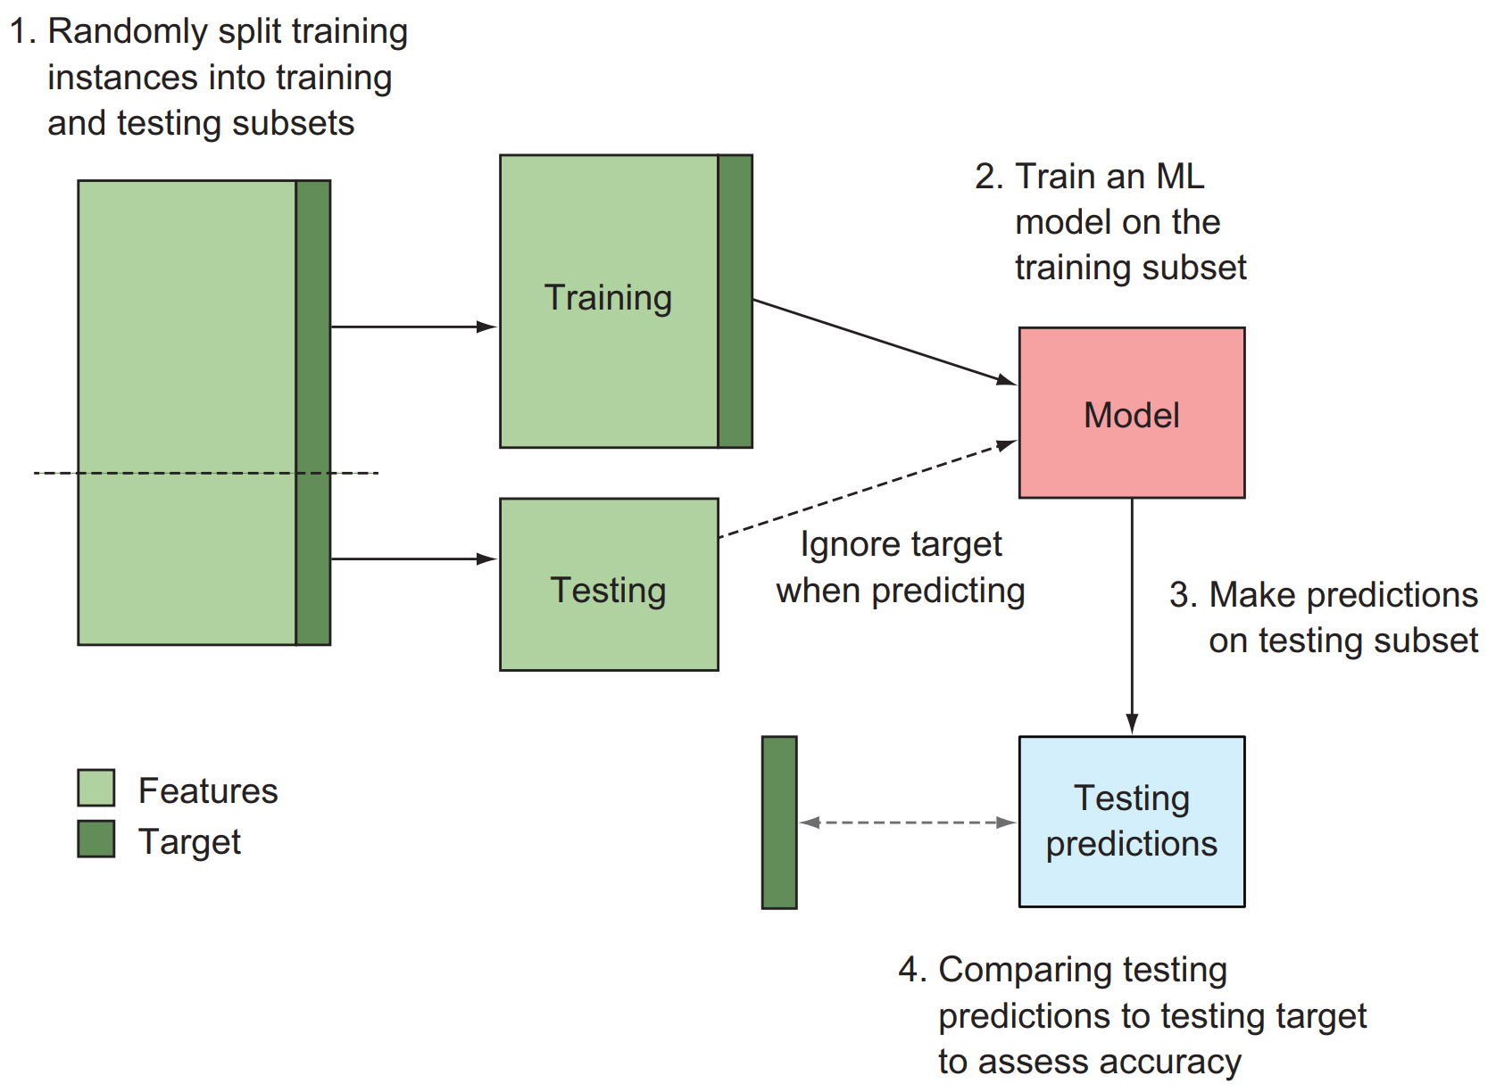
Hold out cross validation

Slide 12
Hold out cross validation
# assume that we begin with two inputs:
# features – a matrix of input features
# target – an array of target variables corresponding to those features
features = rand(100,5)
target = rand(100) > 0.5
N = features.shape[0] # The total number of instances
N_train = floor(0.7 * N) # The total number of training instances
idx = random.permutation(N)
idx_train = idx[:N_train]
idx_test = idx[N_train:]
features_train = features[idx_train,:]
target_train = target[idx_train]
features_test = features[idx_test,:]
target_test = target[idx_test]
# Build, predict, evaluate (to be filled out)
# model = train(features_train, target_train)
# preds_test = predict(model, features_test)
# accuracy = evaluate_acc(preds_test, target_test)

Slide 13
Hold out cross validation
If we apply the holdout method to the corn production data using 70/30 split we may get the graph of the next slide
Two main things stand out
The error estimates computed by the holdout method are close to the new-data error of the model
They’re certainly much closer than the training set error estimates, particularly for small-bandwidth values
The holdout error estimates are noisy
They bounce around wildly compared to the smooth curve that represents the error on new data

Slide 14
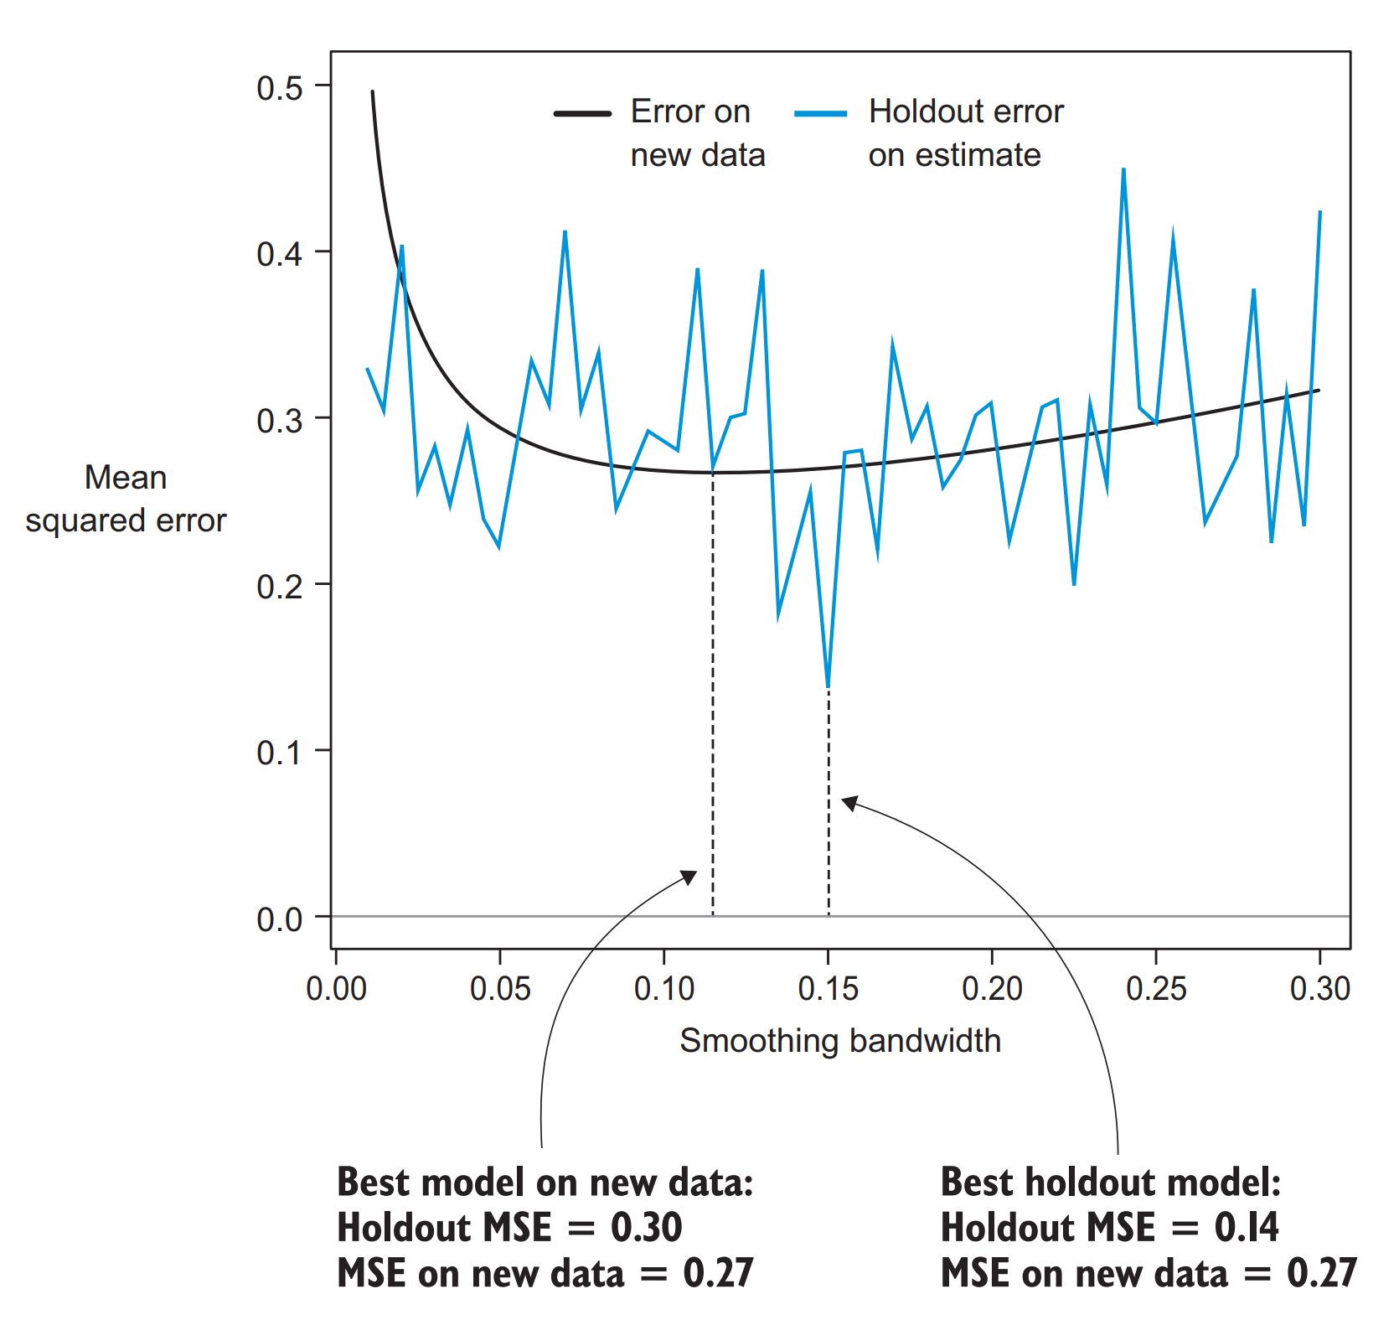
Hold out cross validation

Slide 15
K-fold cross validation
A better but more computationally intensive approach to cross-validation is k-fold cross validation
Like the holdout method, k-fold cross-validation relies on quarantining subsets of the training data during the learning process
The primary difference is that k-fold CV begins by randomly splitting the data into k disjoint subsets, called folds (typical choices for k are 1, 5, 10, or 20)
When k is 1, it is called leave one out cross validation
For each fold, a model is trained on all the data except the data from that fold and is subsequently used to generate predictions for the data from that fold
After all k-folds are cycled through, the predictions for each fold are aggregated and compared to the true target variable to assess accuracy

Slide 16
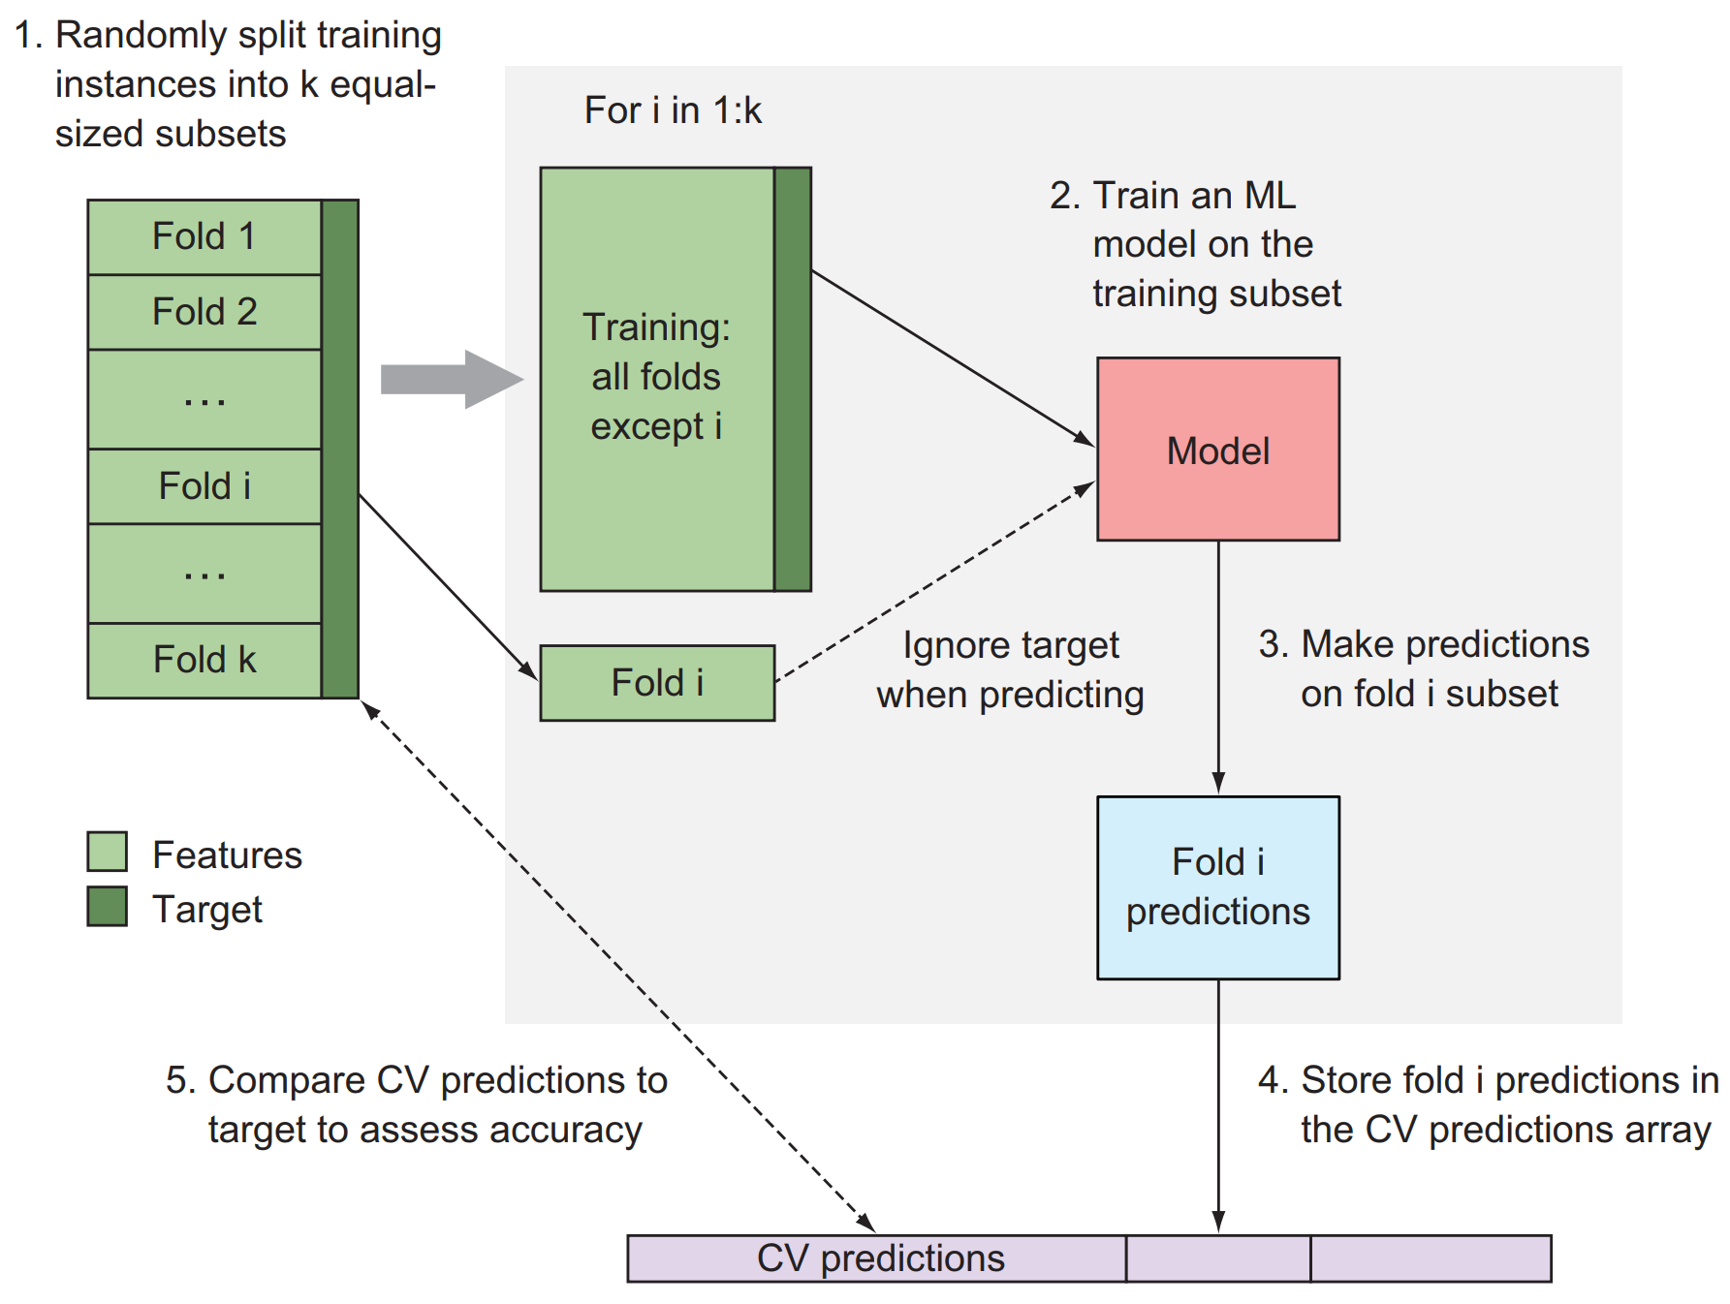
K-fold cross validation

Slide 17
K-fold cross validation: pseudo code
N = features.shape[0]
K = 10 # number of folds
preds_kfold = np.empty(N)
folds = np.random.randint(0, K, size=N)
for idx in np.arange(K):
features_train = features[folds != idx,:]
target_train = target[folds != idx]
features_test = features[folds == idx,:]
# Build and predict for CV fold (to be filled out)
# model = train(features_train, target_train)
# preds_kfold[folds == idx] = predict(model, features_test)
# accuracy = evaluate_acc(preds_kfold, target)

Slide 18
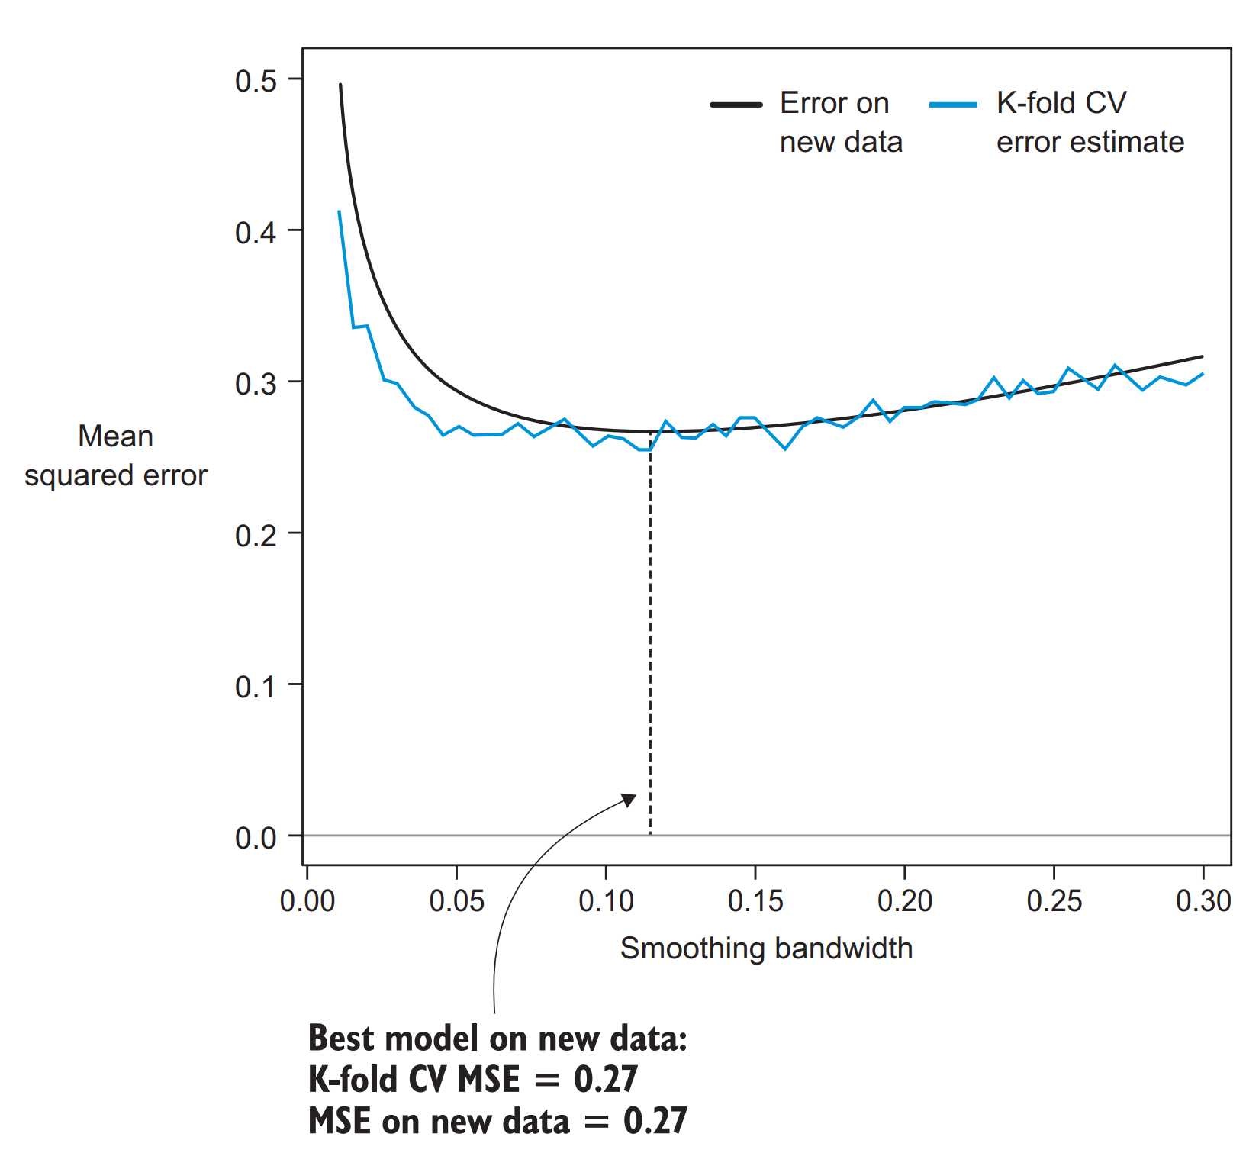
K-fold cross validation

Slide 19
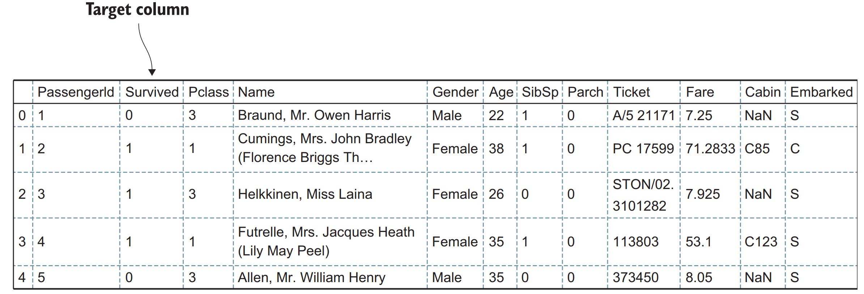
Choose classification models
We want to predict whether a Titanic passenger would survive, based on personal, social, and economic factors
We want to train a classifier that could relate all this information we have to the passengers’ survival probability

Slide 20
Cross validation intuition – again
Frist step – cross-validation
We divide the full dataset into training and testing sets and use the holdout method/k-fold of cross-validation
The model will be built on a training set and evaluated on a held-out testing set
It’s important to reiterate that our goal isn’t necessarily to obtain the maximum model accuracy on the training data
But to obtain the highest predictive accuracy on unseen data
In the model-building phase, we are not yet in possession of this data, by definition, so we pretend that some of the training data is hidden for the learning algorithm

Slide 21
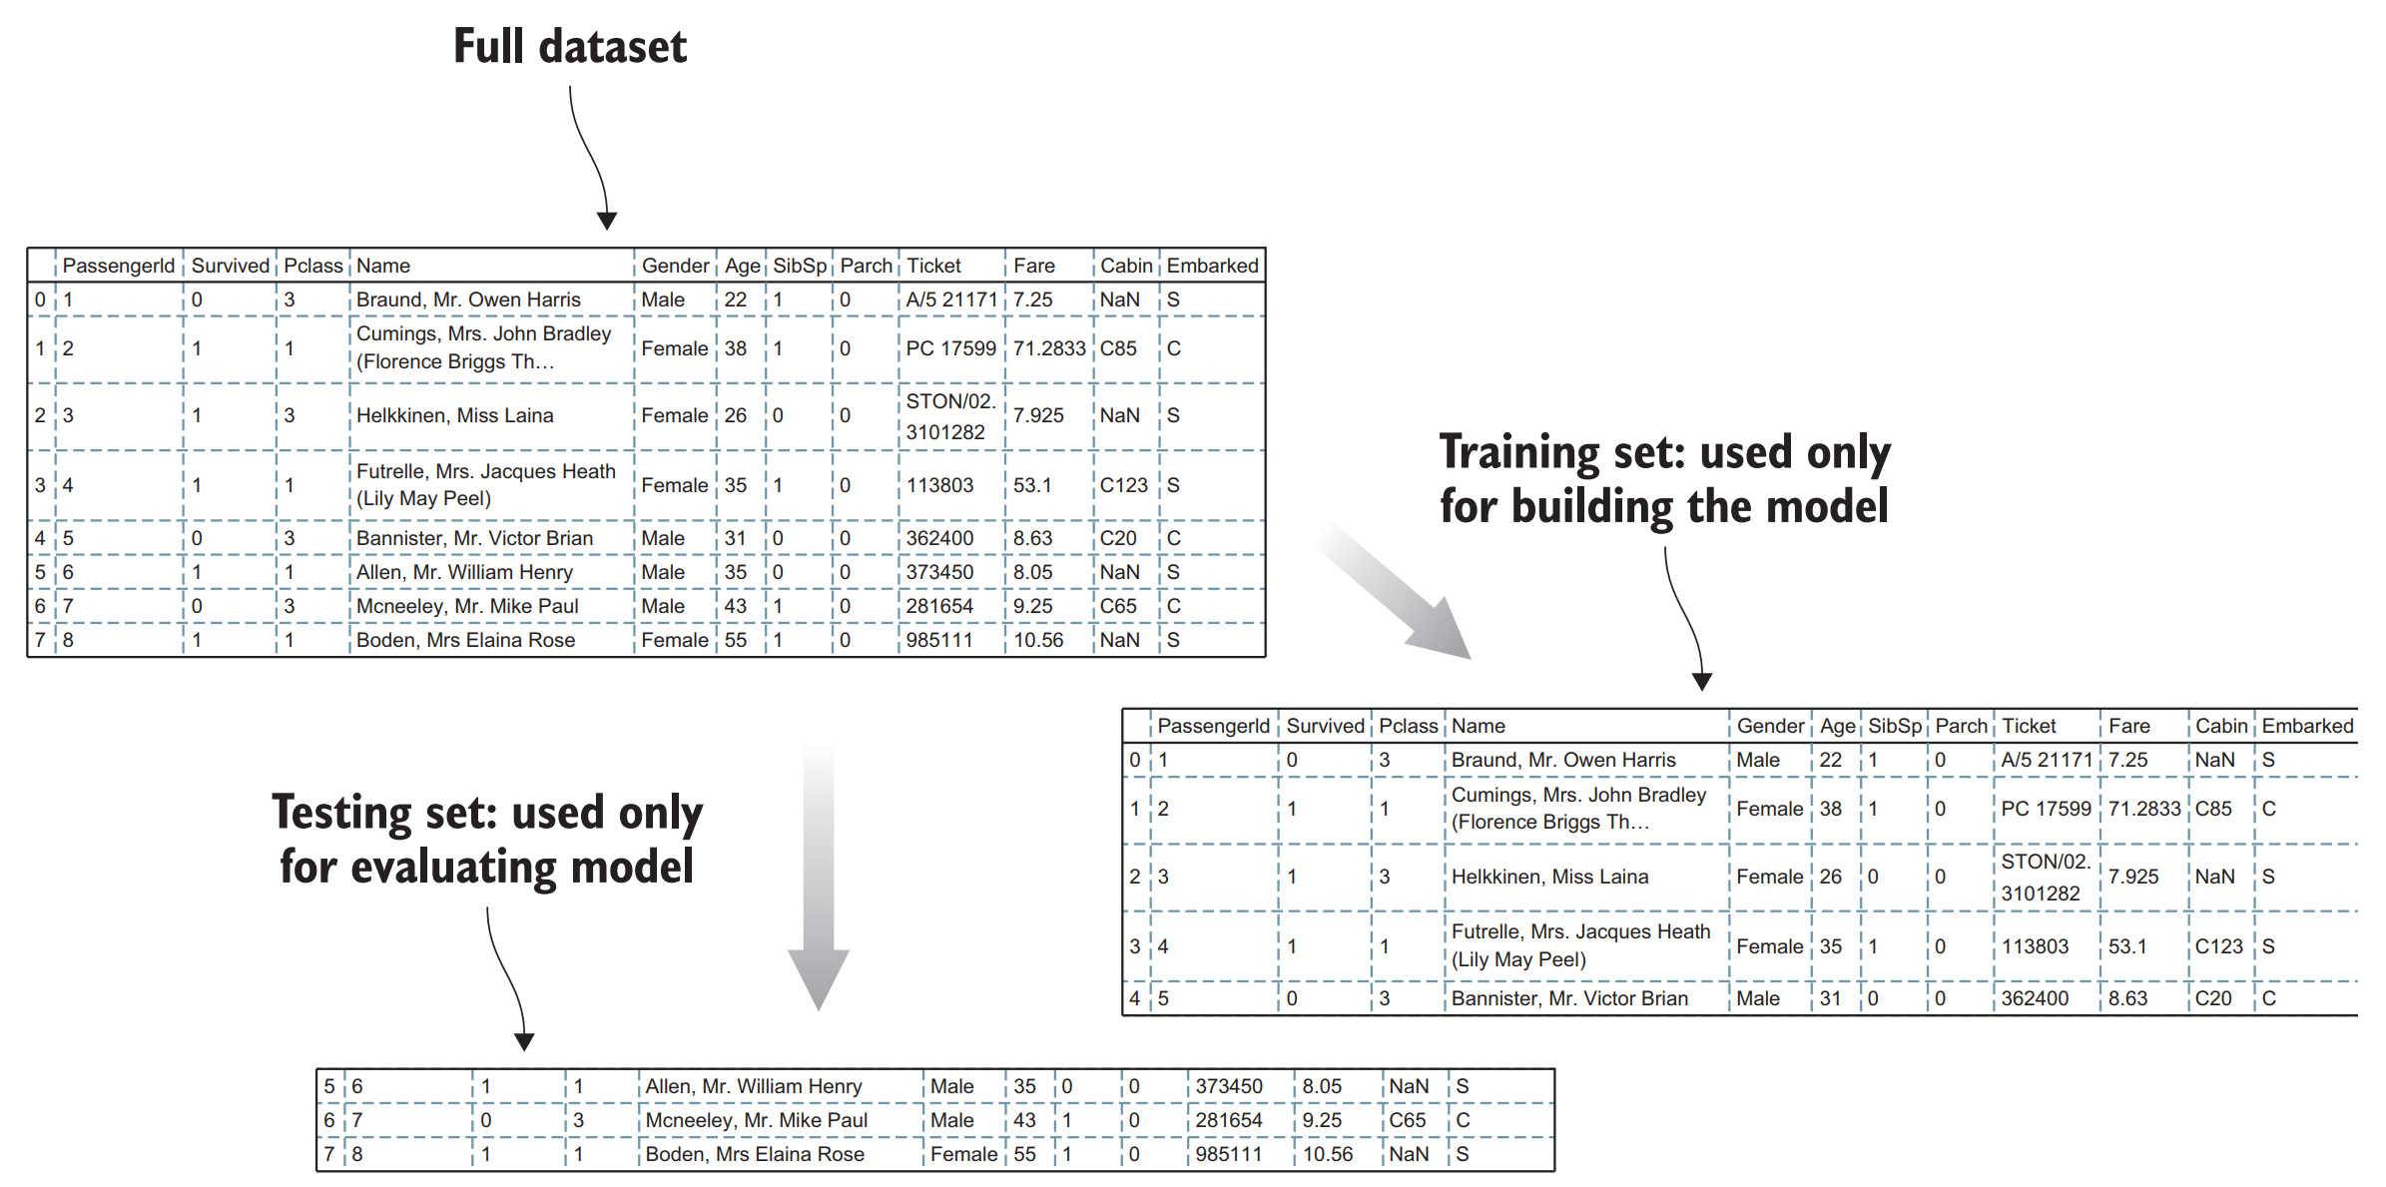
Cross validation intuition – again

Slide 22
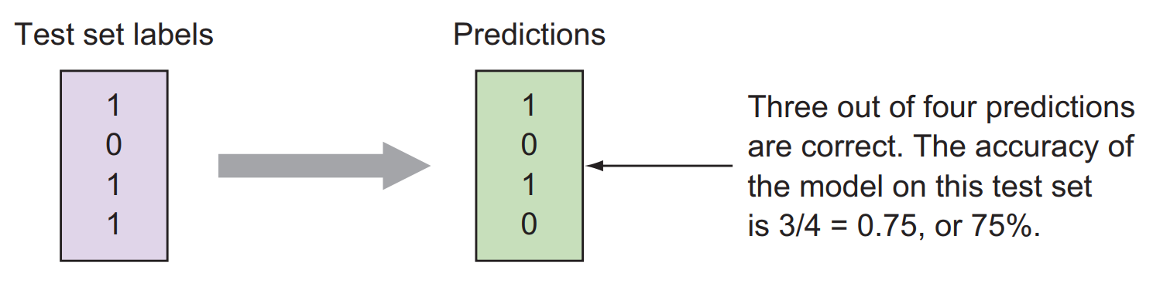
Accuracy metric – MSE for classification?
The simplest performance measure of a classification model is to calculate the fraction of correct answers
If three out of four rows were correctly predicted, we can say that the accuracy of the model on this particular validation set is 3/4 = 0.75, or 75%

Slide 23
Class accuracy
The predictions should provide more information than simply being correct or not
We should be able to analyze the accuracy per class (how many were predicted to survive but actually died or survived)
For binary classification, you can be wrong in two ways – predicting 0 when the correct value is 1, or predicting 1 when the correct value is 0
In many classification problems, it’s useful to go beyond the simple counting accuracy and look at this class-wise accuracy, or class confusion

Slide 24
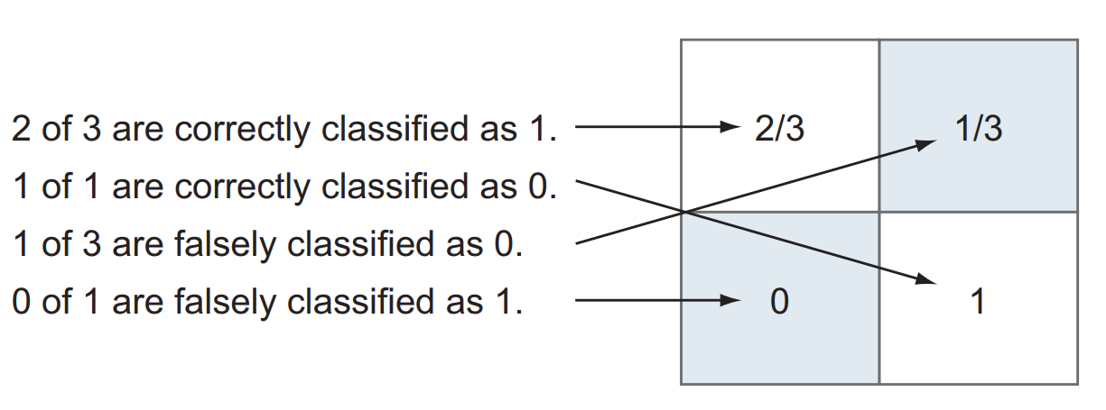
Accuracy – confusion matrix
It turns out to be useful to display these four numbers in a two-by-two diagram called a confusion matrix

Slide 25
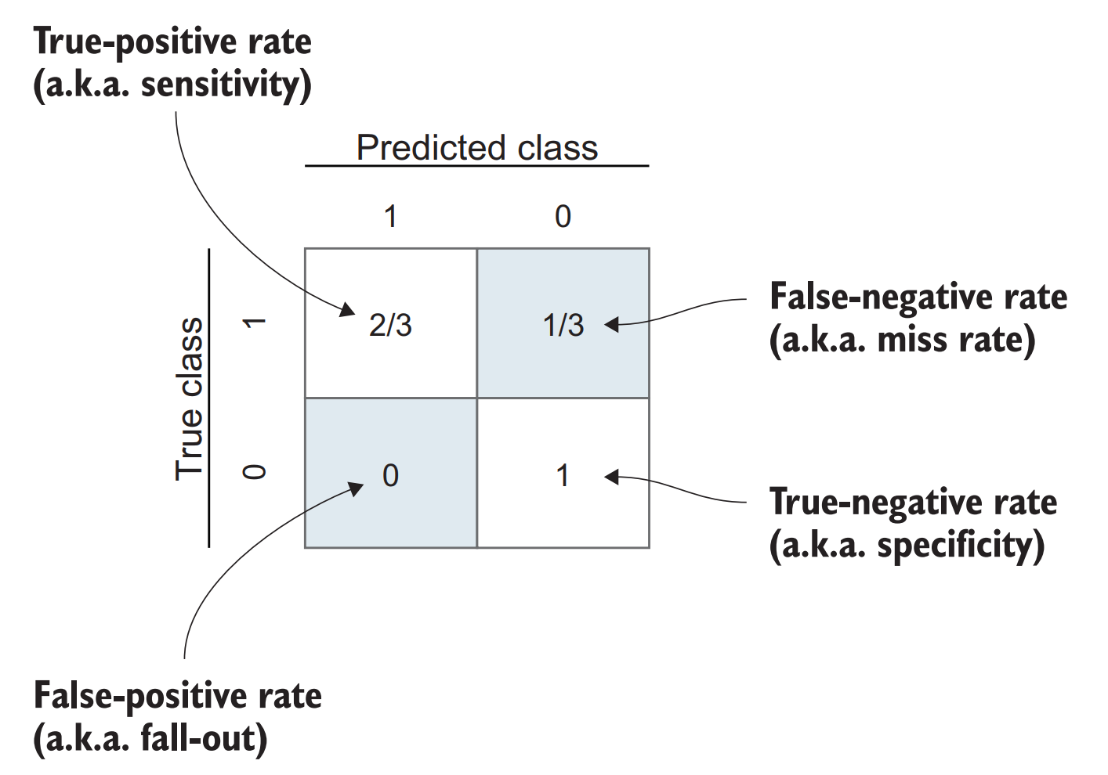
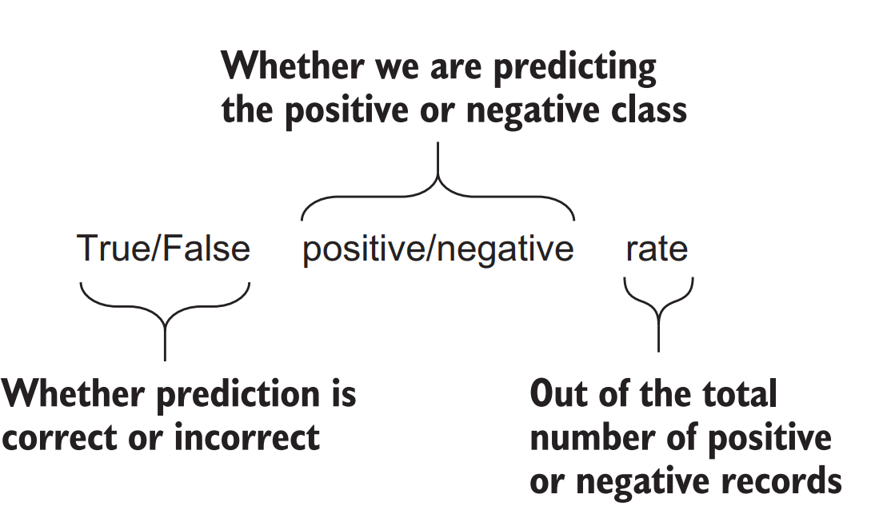
Confusion matrix
Each element in the matrix shows the class-wise accuracy or confusion between the positive and the negative class
They are related to the general concept of receiver operating characteristics (ROCs)

Slide 26
Accuracy tradeoffs
So far we have looked only at predictions for which the output is the predicted class; in our Titanic example, 1 for survival and 0 otherwise
Machine-learning predictions usually hold a degree of uncertainty, and many classification algorithms output not only the zero-one predictions, but the full prediction probabilities
For example, what was simply predicted as survived in our Titanic model may have had a probability of survival of 0.8, 0.99, or 0.5
It’s clear that there’s a big difference in the confidence of these answers

Slide 27
ROC Curve
The output of a probabilistic classifier is the probability vectors or class probabilities
For every row in the test set, we get a real-valued number from 0 to 1 for every class in the classifier (summing to 1)
Until now, you’ve made predictions by considering probabilities above 0.5 to determine the class predictions, from which we calculated all the performance metrics
We say that the threshold that determines the class is 0.5
It’s clear that we could choose any other threshold and would get different values for all of our metrics

Slide 28
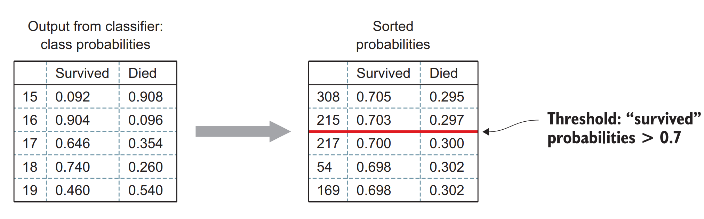
Threshold for survivality

Slide 29
ROC Curve
Figure in next slide shows the process of sorting the probability vectors and setting a threshold of 0.7.
All rows above the line are now predicted to survive, and you can compare these to the actual labels to get the confusion matrix and the ROC metrics at this particular threshold
If we follow this process for all thresholds from 0 to 1, we get the ROC curve, shown in next slide
Here we can read out the confusion matrix at all thresholds, making the ROC curve a powerful visualization tool when we’re evaluating classifier performance

Slide 30
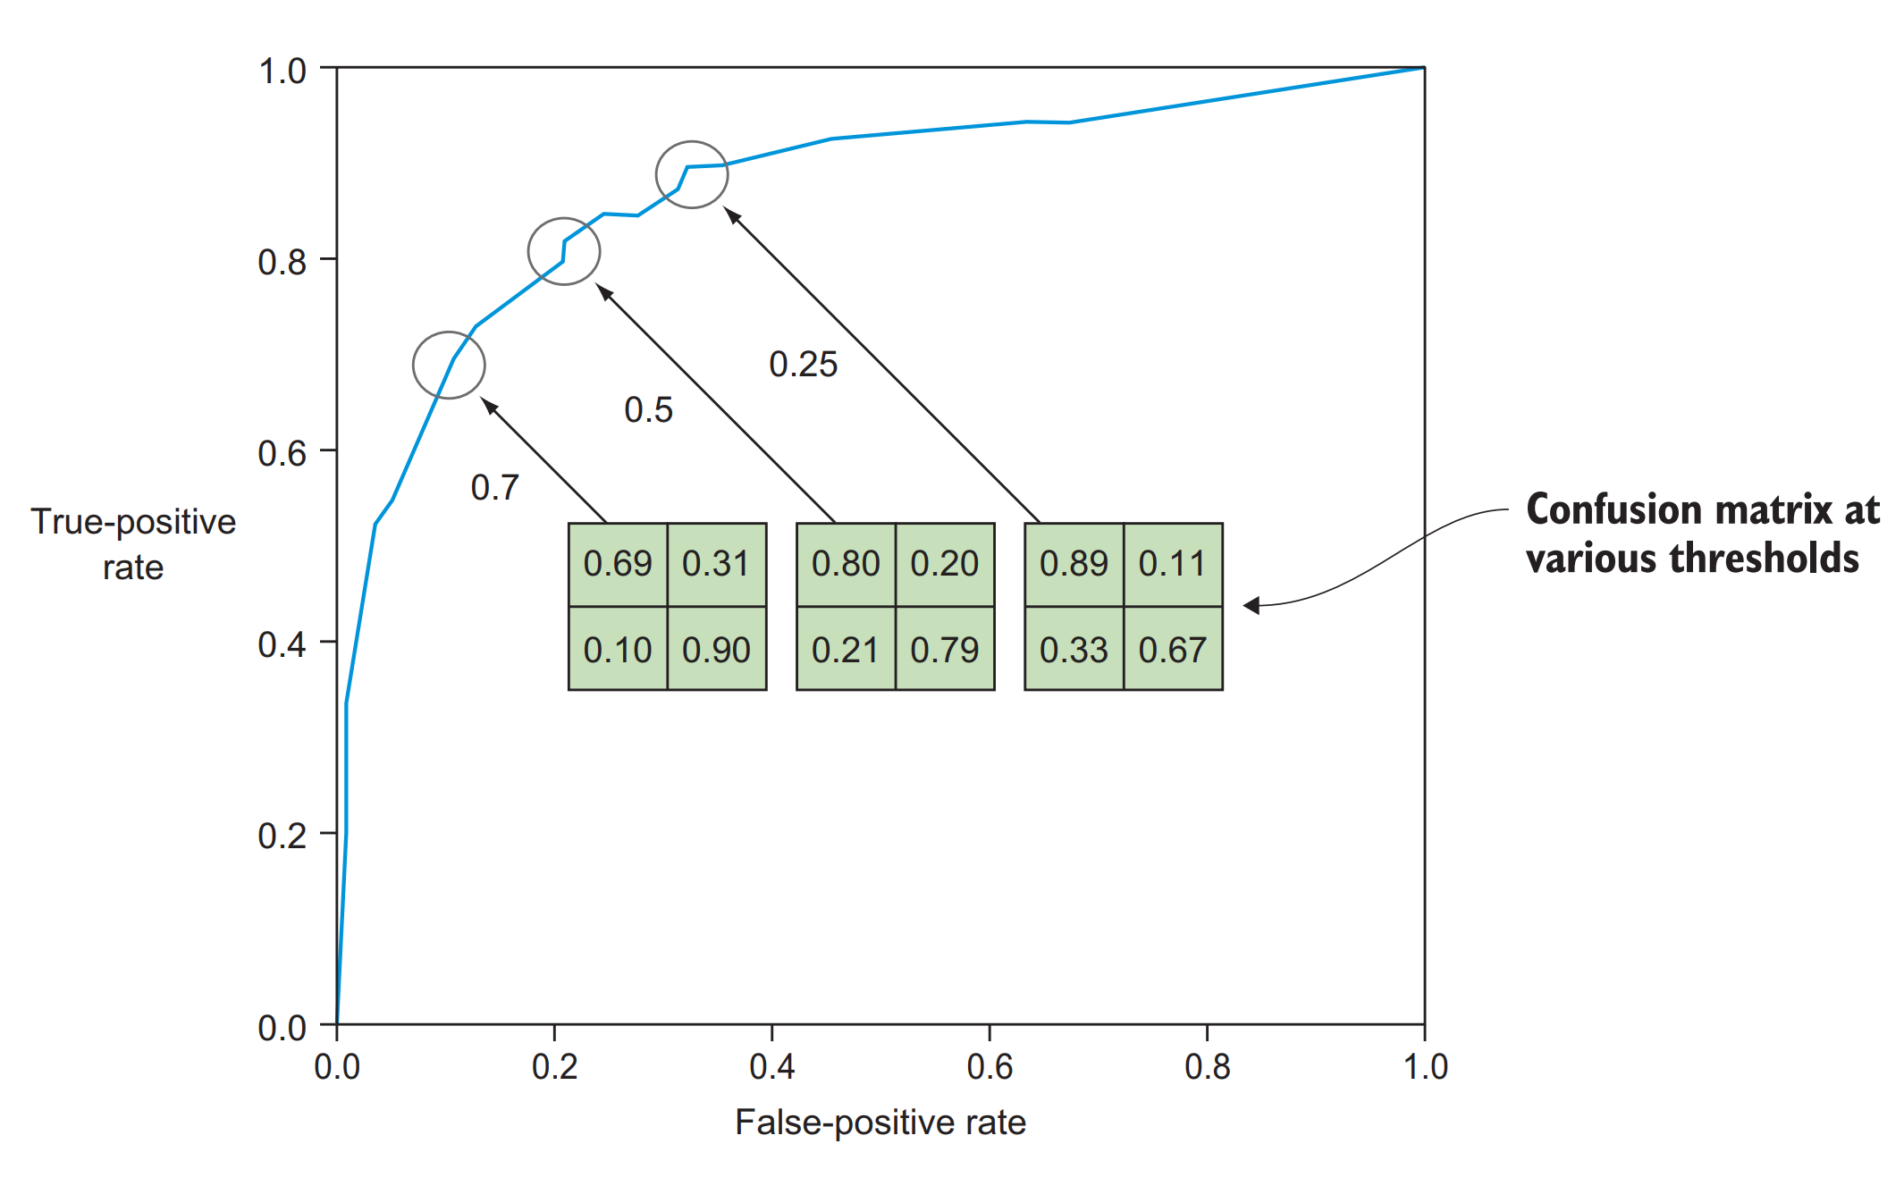

Slide 31
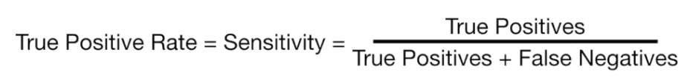
Definitions

Slide 32
AUC
The ROC curve itself also provides a view of the overall performance of the classifier
A perfect classifier would have no false positives and no missed detections, so the curve would be pushed to the top-left corner, as illustrated in the next (slide’s) figure
This leads us naturally to another evaluation metric: the area under the ROC curve (AUC)
The larger this area, the better the classification performance
The AUC is a widely used choice for evaluating and comparing models, although in most cases it’s important to inspect the full ROC curve

Slide 33
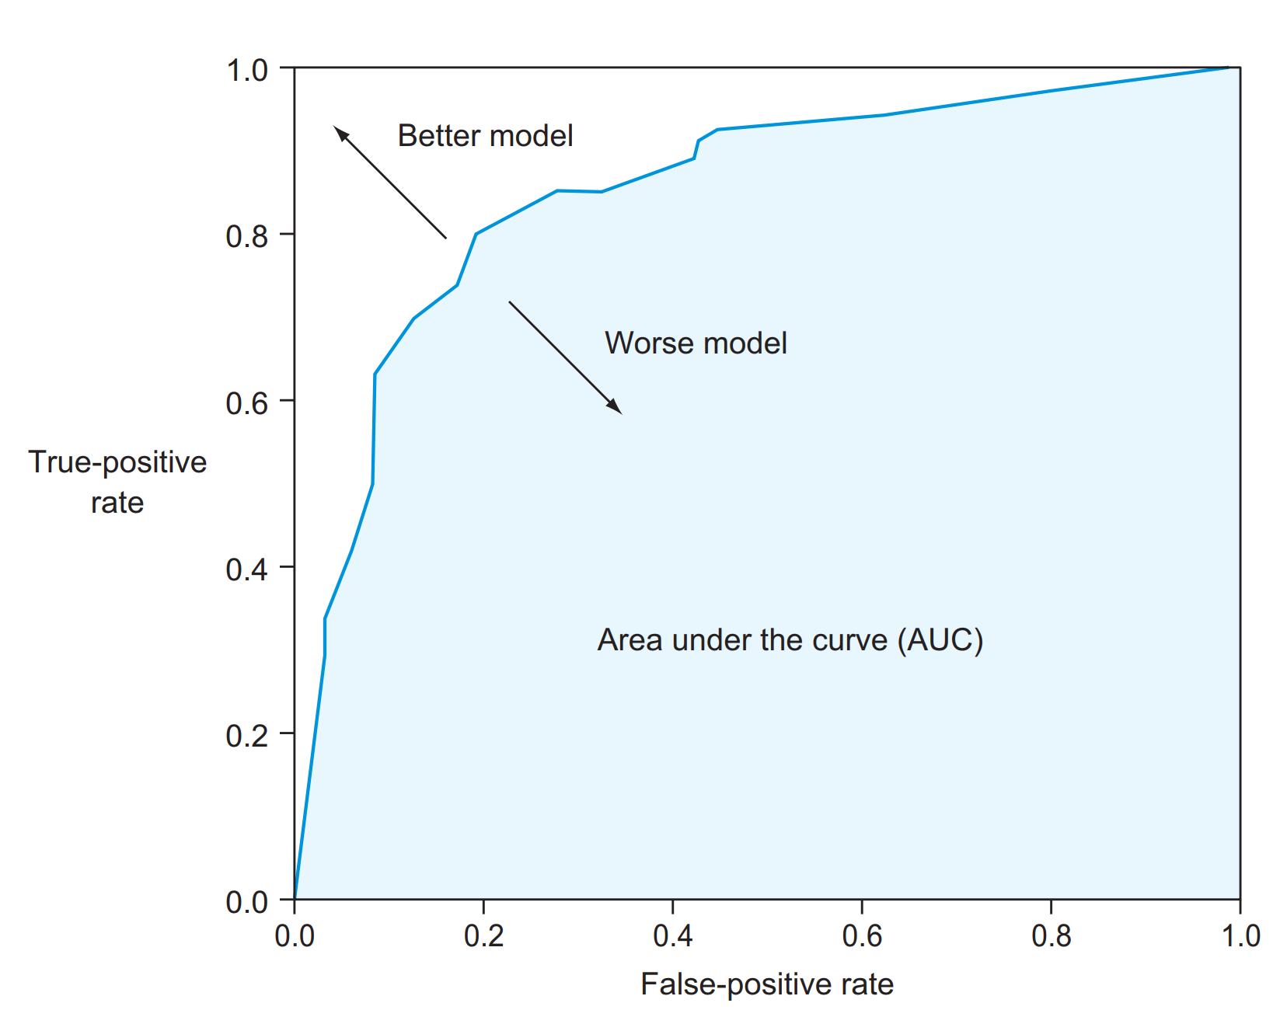

Slide 34
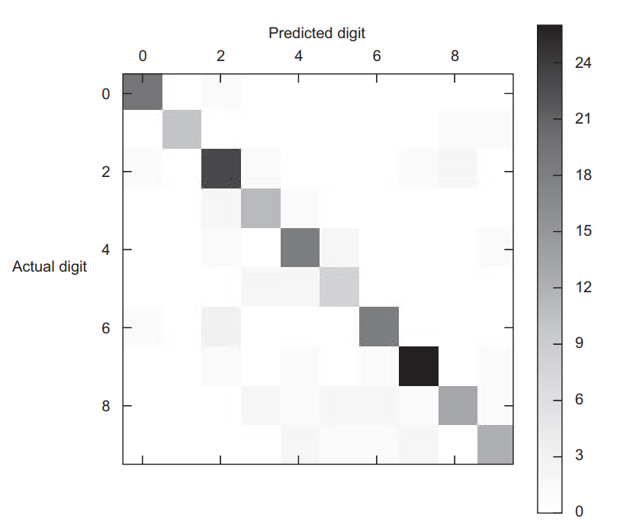
Multiclass confusion matrix
So far you’ve looked only at binary, or two-class, classification problems, but we can use the same tools for multiclass classifiers
A well-known multiclass classification problem is handwritten digit recognition

Slide 35
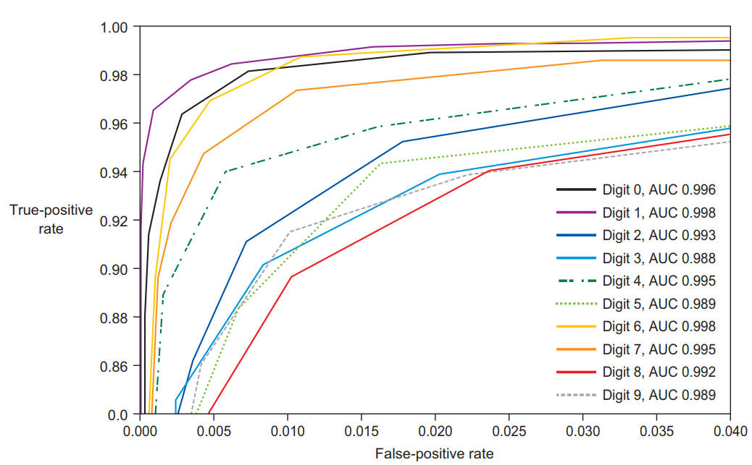
Multiclass classification AUC

Slide 36
Information Criteria
Information criterion is a measure of the goodness of fit of an estimated statistical model.
It is grounded in the concept of entropy,
Offers a relative measure of the information lost
Describes the tradeoff precision and complexity of the model
An IC is not a test on the model in the sense of hypothesis testing
It is a tool for model selection
Given a data set, several competing models may be ranked according to their IC
The model with the lowest IC is chosen as the “best”

Slide 37
Information Criteria
IC rewards goodness of fit, but also includes a penalty that is an increasing function of the number of estimated parameters.
This penalty discourages overfitting.
The IC methodology attempts to find the model that best explains the data with a minimum of free parameters.
IC judges a model by how close its fitted values tend to be to the true values.
the AIC value assigned to a model is only meant to rank competing models and tell you which is the best among the given alternatives.

Slide 38
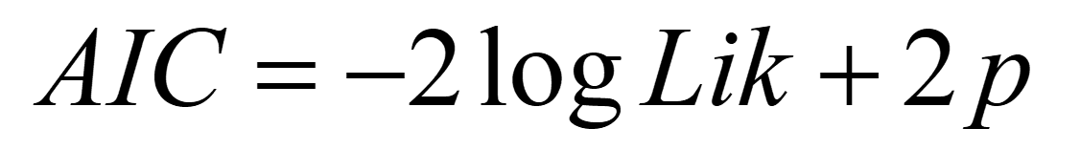
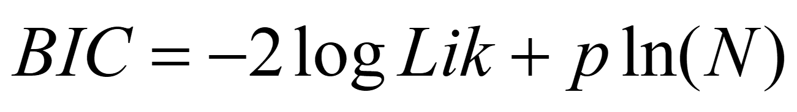
Akaike Information Criteria (AIC)
Akaike, Hirotugu (1974). "A new look at the statistical model identification".
IEEE Transactions on Automatic Control 19 (6): 716–723..
Bayesian Information Criteria
Schwarz, Gideon E. (1978). "Estimating the dimension of a model".
Annals of Statistics 6 (2): 461–464.

Slide 39
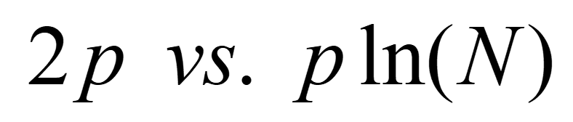
AIC versus BIC
BIC and AIC are similar
Different penalty for number of parameters
The BIC penalizes free parameters more strongly than does the AIC.
Implications: BIC tends to choose smaller models
The larger the N, the more likely that AIC and BIC will disagree on model selection

